Slide 1
Module 3: Azure Machine Learning Hyperparameter tuning

Slide 2
Hyperparameter tuning

Slide 3
Data Science Building Blocks Project
Experimentation
Hyperparameter tuning
pipelines
Deployment
Monitor and Retrain
Classical ML
Deep learning
Data
Data stores
Data sets
Managed Compute
Azure Machine Learning compute cluster

Slide 4
Data Science Building Blocks Project
Experimentation
Hyperparameter tuning
pipelines
Deployment
Monitor and Retrain
Classical ML
Deep learning
Data
Data stores
Data sets
Managed Compute
Azure Machine Learning compute cluster

Slide 5
Which features?
Which algorithm?
Which parameters?
Mileage
Condition
Car brand
Year of make
Regulations
…
Gradient Boosted
Nearest Neighbors
SVM
Bayesian Regression
LGBM
…
Parameter 1
Parameter 2
Parameter 3
Parameter 4
…
Mileage
Gradient Boosted
Criterion
Loss
Min Samples Split
Min Samples Leaf
Others
Car brand
Year of make
30%
Model

Slide 6
Which features?
Which algorithm?
Which parameters?
Mileage
Condition
Car brand
Year of make
Regulations
…
Gradient Boosted
Nearest Neighbors
SVM
Bayesian Regression
LGBM
…
Criterion
Loss
Min Samples Split
Min Samples Leaf
Others
Mileage
Gradient Boosted
N Neighbors
Weights
Metric
P
Others
Condition
Nearest Neighbors
Car brand
Car brand
50%
Year of make
30%
Year of make
Model
Iterate

Slide 7
Which features?
Which algorithm?
Which parameters?
30%
50%
70%
30%
45%
50%
65%
95%
35%
10%
75%
20%
70%
30%
15%
Iterate

Slide 8
Deep learning

Slide 9
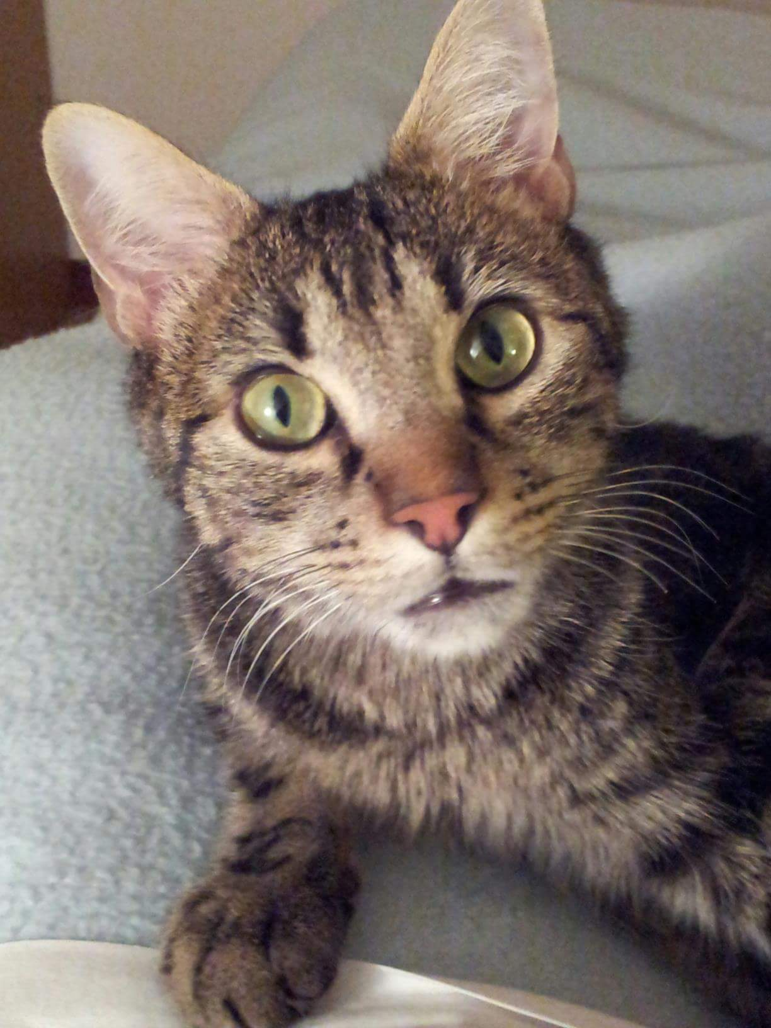




Distributed training mode: Data parallelism
Worker 1
Worker 2
Job manager
CNN model
Subset 1
CNN model
Subset 2
CNN model
Dataset

Slide 10
Distributed training mode: Model parallelism
Worker 1
Worker 2
Job manager
CNN model
Subset 1
CNN model
Subset 2
CNN model
Dataset

Slide 11








Required Deep Learning Frameworks
Popular Deep Learning Frameworks
ONNX
TensorFlow
PyTorch
Scikit-Learn
Community project created by Facebook and Microsoft
Use the best tool for the job. Train in one framework and transfer to another for inference
MXNet
Chainer
Keras

Slide 12
Characteristics of Deep Learning
Massive amounts of training data
Excels with raw, unstructured data
Automatic feature extraction
Computationally expensive

Slide 13
Deep Learning
Three Additional Requirements
Distributed Training on multi-node clusters
Support for advanced processors: TPUs GPUs FPGAs
Support for Deep Learning Frameworks:

Slide 14
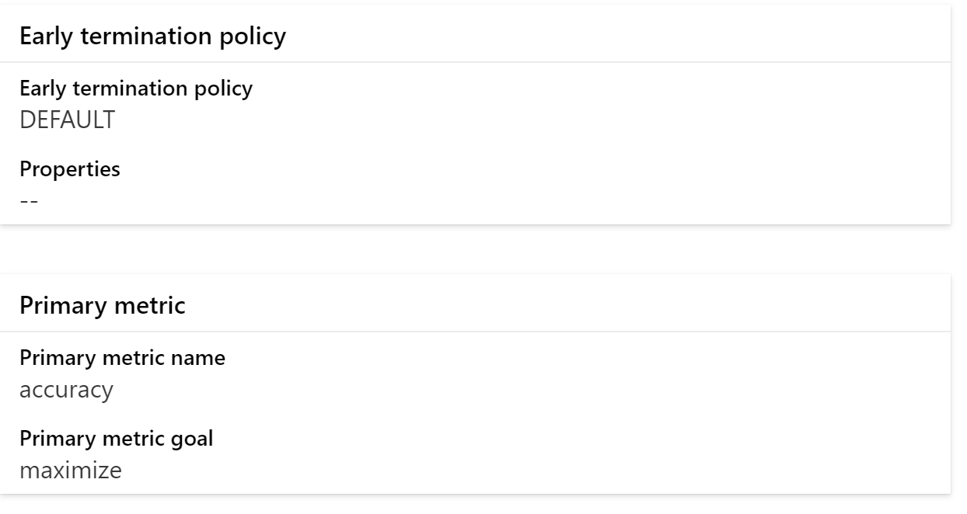
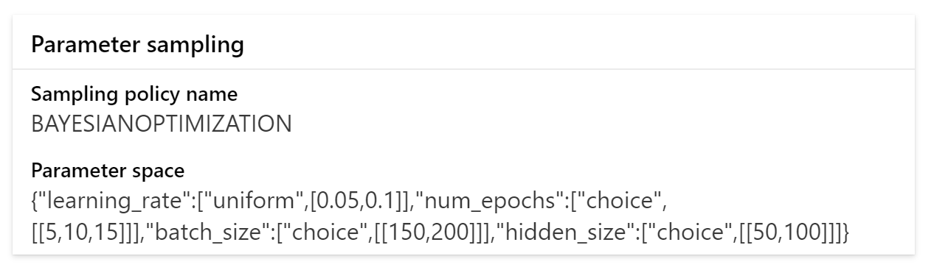
Parent run

Slide 15
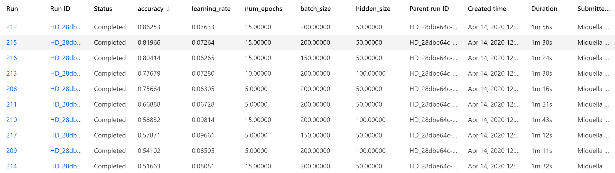
Compare child runs

Slide 16

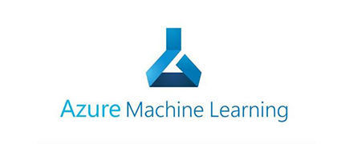
train.py
train_sumit.py
Training script
Run configuration
Conda_dependencies.yml
Experiments
Environment
logs
local
Experiment 1
Parent Run
Compute
Child run
Child run
Child run
…
local
Data

Slide 17
train.py
train_sumit.py
Training script
HyperDrive Run configuration
Conda_dependencies.yml
Search Grid
Experiments
Environment
logs
local
Experiment 1
Parent Run
Compute
Child run
Child run
Child run
…
local
Data

Slide 18
Demo: hyperparameter tuning with Azure ML

Slide 19
Lab_04: Hyperparameter tuning with Azure ML

